Slide 1


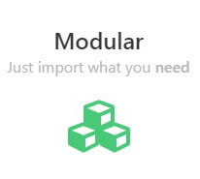
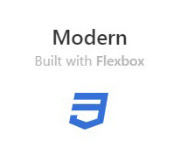


What is Bulma?
Bulma is a Free, Modular And Modern Responsive CSS framework based on Flexbox
An Overview of Bulma Framework

Slide 2
Why Choose
?

Slide 3

Modern features
Using the latest CSS3 features such as Flexbox
Planning on using CSS Variables and CSS Grid

Slide 4

Simple grid System
To build a Bulma grid, you only need a single .columns container to wrap as many .column items as you want

Slide 5
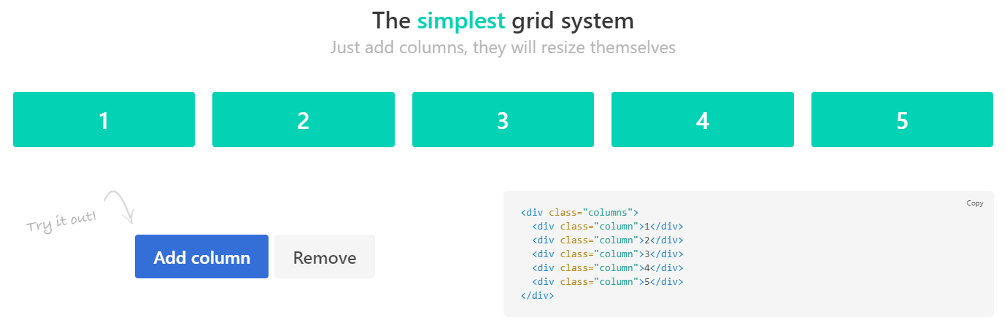

Slide 6
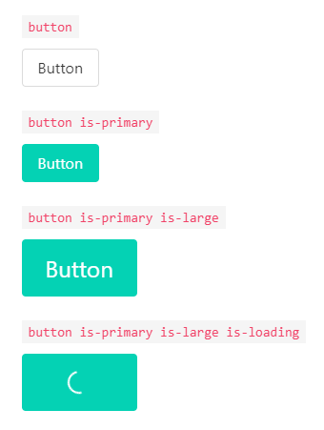

Modern features
Simple readable class names like .button or .title
Straightforward modifiers system like .is-primary
So easy to learn
Get a design started within minutes

Slide 7

Font Awesome 5 support
Bulma is compatible with both Font Awesome 4 and Font Awesome 5 thanks to the .icon element

Slide 8

100+ useful CSS helpers
Bulma ships with more than 100 helpers to specify color, display, and spacing
Responsive helpers
Typography helpers
Other helpers

Slide 9


No JavaScript
By focusing only on CSS, Bulma provides a lightweight solution that can easily be implemented in any development context

Slide 10

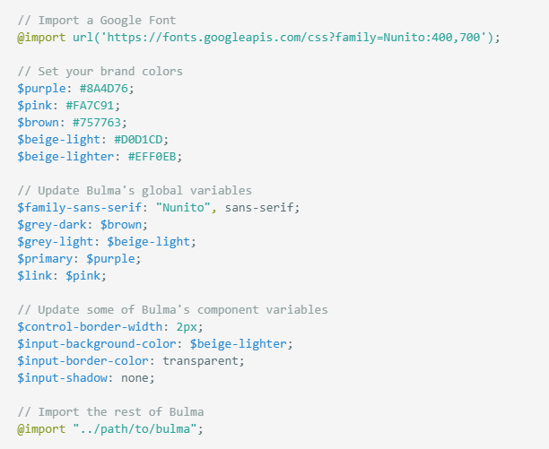
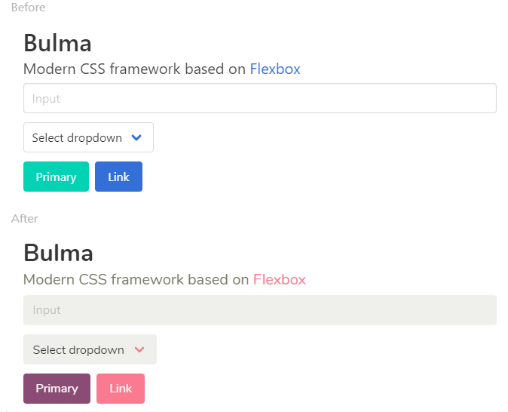
So quick to customize
Simply set your own Sass variables before importing Bulma

Slide 11


Slide 12
